Slide 1
Marketing & Lead Funnel Data
By
Gomolemo moabalobelo

Slide 2
TABLE OF CONTENTS
Introduction 3
Monthly Conversion Rates 4
Monthly visitors and drop-off rates 5
Performance of Referral Channels 6-7
Recommendations 8
Conclusion 9

Slide 3
INTRODUCTION
Project Overview
This project focused on analyzing customer behaviour across the full marketing funnel, from visitors to leads and finally to converted customers. The goal was to understand how users interact with the business across different referral channels and how this behaviour changes over time.
Analysis Performed
The analysis examined total visitors, lead generation, lead drop-off rates, and customer conversions. It also compared performance across different referral channels such as Google, Direct, Email, and Social Media, as well as monthly performance trends throughout the year.
Key Focus of the Analysis
The main focus was to identify which channels and months perform best and worst in driving traffic, leads, and conversions. It also aimed to highlight weak points in the customer journey, especially where users drop off before becoming leads or customers. This helps the business understand where improvements are needed to increase overall performance and consistency.

Slide 4
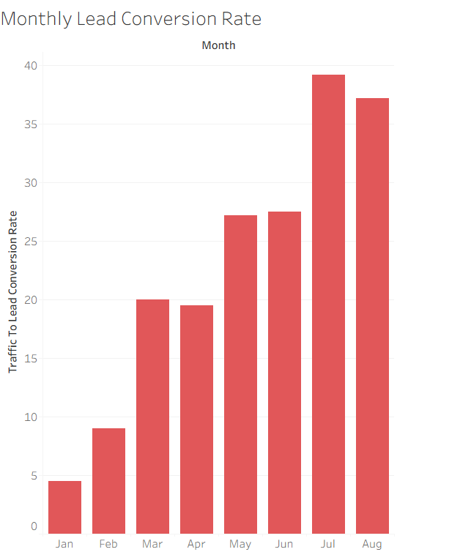
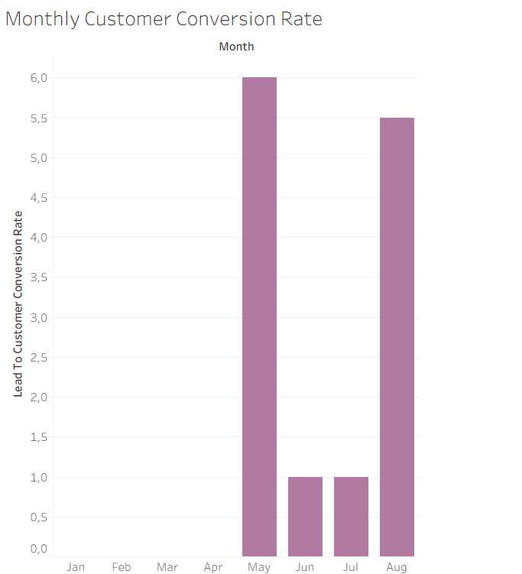
Monthly Conversion Rates
Key Insights
The highest lead conversion rate was achieved in July (39.17%), followed by August (37.17%), indicating that the business performs strongest in converting leads during the mid-year period.
January recorded the lowest lead conversion rate at 4.5%, followed by February at 9%, highlighting a significant decline in customer conversion performance at the beginning of the year.
Business Insights
The business should analyze the marketing campaigns, promotional activities, and customer engagement strategies implemented during July and August to identify successful practices that can be replicated in lower-performing months
Key Insights
Customer conversion performance was strongest in May (6%) and August (5.5%), while June and July recorded low conversion rates of 1%. No customer conversions were achieved in January, February, and March, indicating weak customer acquisition performance at the beginning of the year.
Business Insights
The business should evaluate the successful strategies used in May and August and strengthen lead nurturing, marketing, and sales follow-up processes to improve customer conversions and achieve more consistent performance throughout the year. Additionally, the company should introduce targeted campaigns during low-performing periods to increase customer acquisition and stabilize conversion performance.

Slide 5
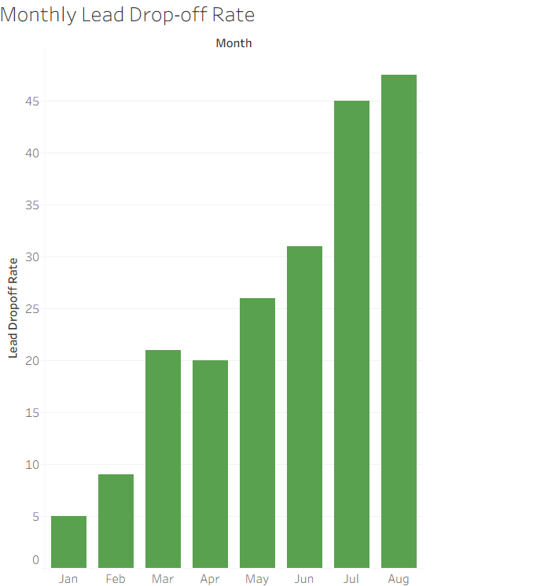
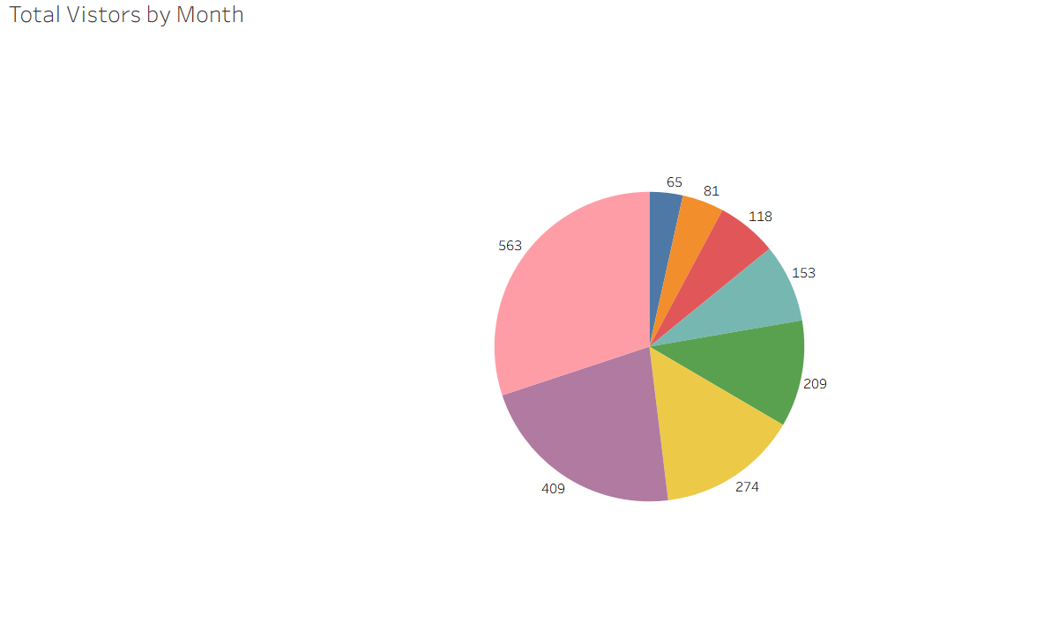
Monthly visitors and drop-off rate
Key Insights
August recorded the highest lead drop-off rate at 47.50%, followed by July at 45%, indicating that nearly half of the leads were lost during these months before converting further in the sales funnel. In contrast, January (5%) and February (9%) had the lowest drop-off rates, showing stronger lead retention at the beginning of the year.
Business Insights
The business should focus on improving lead nurturing and follow-up processes during high drop-off months such as July and August to reduce lost opportunities. Understanding customer behaviour and reviewing campaign effectiveness during these periods can help identify gaps in engagement.
Key Insights
August recorded the highest number of visitors at 563 (30.1%), followed by July with 409 (21.8%), indicating that most traffic is concentrated in the mid-year period. In contrast, January had the lowest visitors at 65 (3.5%), followed by February at 81 (4.3%), showing very low engagement at the start of the year.
Business Insights
The business should replicate the marketing strategies and traffic-driving channels used in July and August to improve performance in lower-performing months. Increasing awareness campaigns during January and February can help balance traffic distribution throughout the year. Additionally, optimizing conversion efforts during peak periods is critical to maximize revenue opportunities.

Slide 6
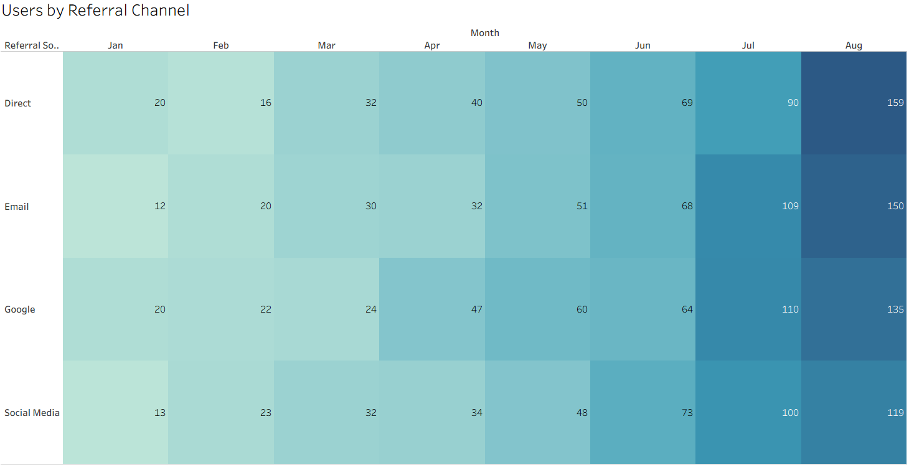
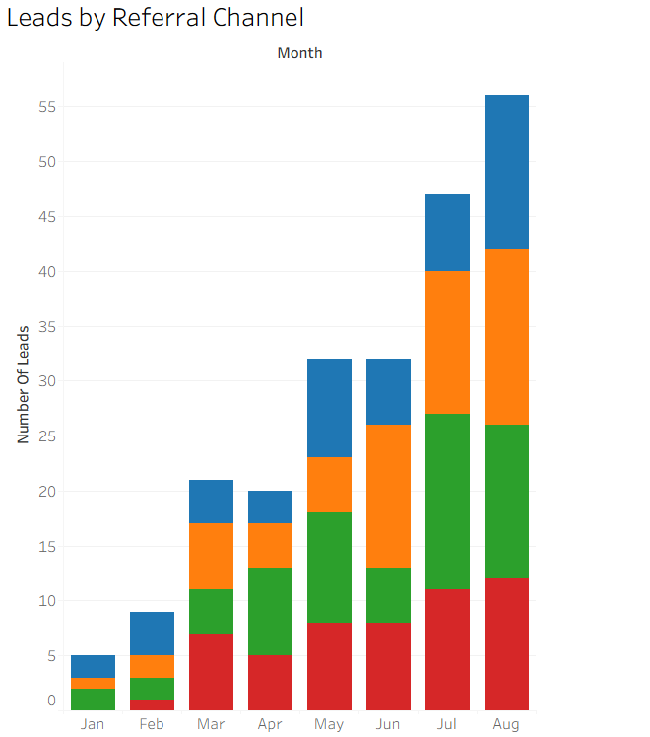
Performance of Referral Channels
Key Insights
Google generated the highest referred users (482), while Social Media had the lowest (442), showing relatively close performance with Google slightly stronger.
August recorded the highest referrals (563), while January had the lowest (65), with Direct being strongest in August (159) and Email the weakest in January (12).
Business Insights
The business should focus on optimizing high-performing channels like Google and Direct to maximize user acquisition, especially during peak months such as August.
Social Media and Email need improved targeting and engagement strategies, while insights from August’s strong performance should be replicated in weaker months like January.
Key Insights
Google generated the highest number of users who became leads (61), while Direct had the lowest (49). August recorded the highest number of leads (54), while January had the lowest (5. In August, Email was the strongest contributor with 61 leads, while Social Media being the least with 12 leads.
Business Insights
The business should prioritize optimizing high-performing channels like Google and Email to maximize lead generation and improve conversion efficiency.
Social Media and Direct channels require improved targeting, engagement, and campaign strategies to increase their contribution to leads.
The strong performance in August should be analyzed and replicated across other months, especially January, to stabilize and improve overall lead generation.

Slide 7
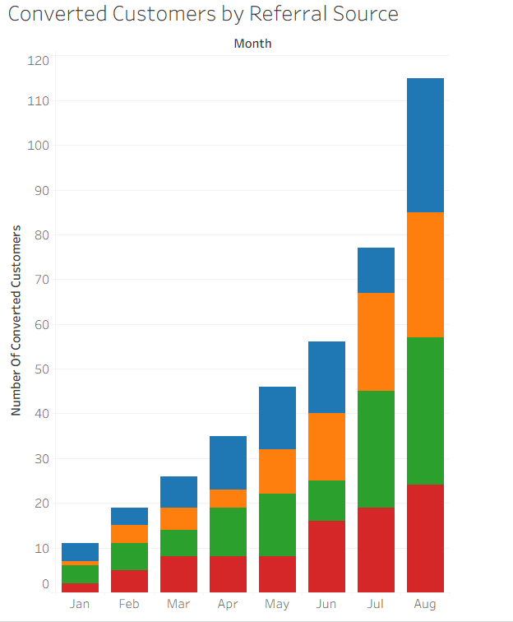
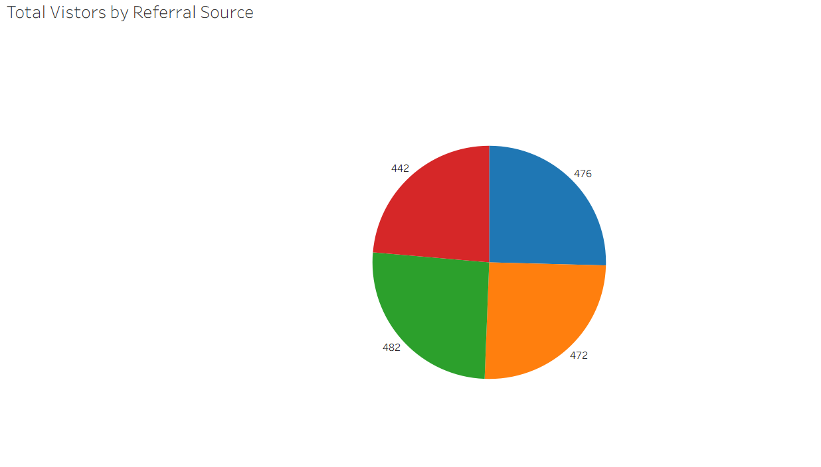
Performance of Referral Channels
Key Insights
Google generated the highest number of converted customers (109), while Email had the lowest (89),.August recorded the highest number of converted customers (115), while January had the lowest (11).In August, Google contributed the most conversions (33), while Social Media contributed the least (24)
Business Insights
The business should prioritize strengthening high-performing channels like Google to maximize customer conversions and overall revenue. Email and Social Media require improved targeting, engagement, and nurturing strategies to increase their conversion contribution. The strong conversion performance in August should be analyzed and replicated in lower-performing months like January to improve consistency in customer acquisition.
Key Insights
Google generated the highest number of total visitors (482), closely followed by Direct (476) and Email (472.Social Media recorded the lowest number of visitors (442), indicating slightly weaker traffic generation compared to other referral sources.
Business Insights
The business should focus on strengthening Social Media performance to close the gap with other channels and improve overall traffic balance.
Since Google, Direct, and Email perform closely, efforts should be made to optimize all three equally to maximize consistent visitor inflow.
A balanced multi-channel strategy should be maintained while improving weaker channels to increase total website traffic and engagement.

Slide 8
RECOMMENDATIONS
The business should focus more on Google, Direct, and Email because they bring in the most visitors, leads, and customers. Improving ads, SEO, and email campaigns can help increase results even more.
Social Media is not performing well compared to other channels. The business should improve its content, targeting, and engagement to attract more users and turn them into leads and customers.
The business should study what worked well in July and August and use the same strategies in weaker months like January and February to improve performance throughout the year.
Lead follow-ups should be improved so fewer potential customers are lost, especially in months where drop-off is high.
The business should plan marketing spending better by investing more during high-performing months but also working to improve low-performing months.

Slide 9
CONCLUSION
Overall, the analysis shows that the business performs differently across the year and across different referral channels. Google is the strongest channel because it consistently brings in the most visitors, leads, and converted customers. Direct and Email also perform well and stay close to Google, showing that these channels are important for driving steady traffic and sales. Social Media, however, performs weaker compared to the other channels and needs improvement to contribute more meaningfully to growth.
Looking at monthly performance, the middle of the year (especially July and August) is when the business performs best. These months have the highest visitors, leads, and conversions, showing that marketing campaigns or customer interest are much stronger during this period. In contrast, the beginning of the year (January, February, and March) shows very weak performance, with very low traffic, almost no leads, and very few or no conversions.
This clearly shows that business performance is not stable throughout the year. It depends heavily on timing and how effective marketing efforts are during different months. There are also issues in the funnel, where many users visit but do not always become leads or customers, especially in high-drop-off months.
In conclusion, the business has strong potential because it performs very well during peak months and through strong channels like Google. However, it needs to fix weak months, improve Social Media performance, and reduce drop-offs in the customer journey. If these improvements are made, the business can achieve more consistent growth and better results throughout the entire year.

